Slide 1
CUSTOMER CHURN ANALYSIS – TELECOM INDUSTRY
KARTHIGA ELANGOVAN
BADM-MBE-WE-12

Slide 2
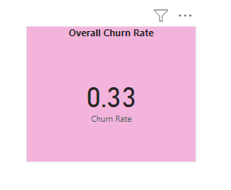
1. Overall churn Rate
This shows the Overall churn Rate

Slide 3
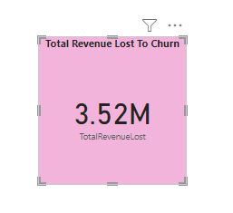
2. Total Revenue Lost to Churn
This Display the total revenue lost due to churn.

Slide 4
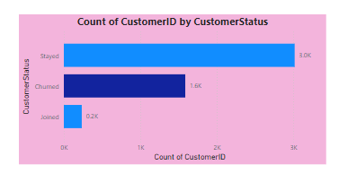
3. Customer Count by Customer Status -Churned
This shows no of Churned Customer(1586).

Slide 5
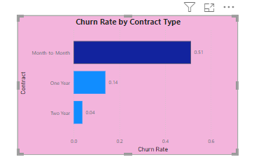
4. Churn Rate By Contract Type
Month-to-Month contracts have a significantly higher churn rate compared to long-term contracts.(0.51)

Slide 6
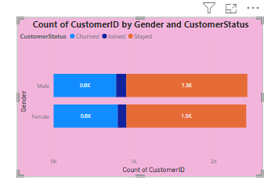
5. Churn by Demographics
This shows the churn no’s according to Gender. Both Gender are almost near to each other.( M-783, F-803)

Slide 7
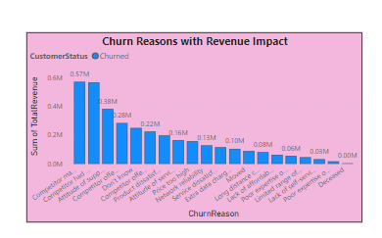
6. Churn Reason with Revenue Impact
"Competitor made better offer" is a leading churn reason, it means customers are leaving due to dissatisfaction with the offers that are provided by the company, resulting in a significant revenue impact.

Slide 8
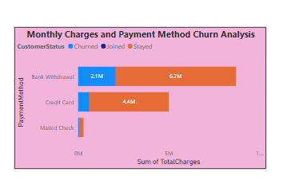
7. Monthy Charges and Payment Method Analysis
If a payment method has a high number of churned customers but also high total charges, it suggests that we should focus on retaining customers using this payment method.( we have to focus on Bank withdrawal customers)

Slide 9
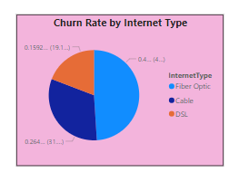
8. Churn Rate by Internet Type
Fiber optic customers may be churn because of service reliability or customer support is inadequate.

Slide 10
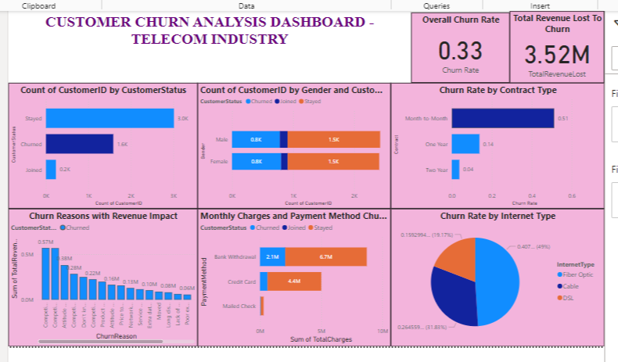
DASHBOARD

Slide 11
To Reduce the Customer Churn
Encourage Long-Term Contracts: Offer discounts or rewards for customers who switch from monthly to annual contracts to improve retention and build customer loyalty.
Optimize Payment Methods: Promote stable payment options like Direct Debit by offering small incentives, reducing payment failures and improving customer satisfaction.
Personalize Retention Strategies: Address churn reasons like pricing or service quality with targeted offers, such as customized discounts, better support, or value-added services.
Focus on High-Value Customers: Identify and retain high-revenue customers through loyalty programs, exclusive offers, and proactive account management.
Enhance Customer Engagement: Increase communication and product usage through personalized emails, in-app tips, and customer success programs to boost engagement and reduce churn.

Slide 12
THANK YOU

